Slide 1
School Board Update
Summer Communications Plan
September 21, 2017
Campbell Union High School District

Slide 2

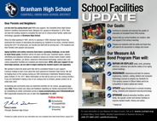
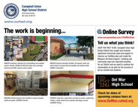


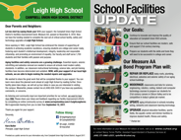
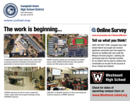
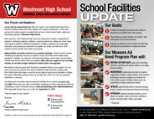
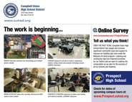
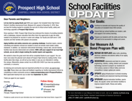
Summer Listening Summary
5 customized mailers were sent to Campbell UHSD Parents and Voters in approximately 65,000 households.
1

Slide 3






Summer Listening Summary
Using the online tool – SurveyMonkey – five surveys were created customized by high school designed to solicit input from the CUHSD community about the District overall and the facilities plans for school.
The survey links were included on:
Each of the 65,000 mailers
The District‘s home page, Facebook and Twitter
The website, Facebook and Twitter for each of the five high schools
Two targeted online campaigns to CUHSD voters
over a seven day period
We received 71 total responses.
Of those who responded, over 40% indicated they were CUHSD parents.
2

Slide 4






Summer Listening Summary
Online Ads
820,955 ad impressions were delivered to CUHSD Registered Voters age 18 – 59 via both desktop and mobile device ads.
42,373 ad impressions were delivered to CUHSD Registered Voters age 18 – 59 via their Facebook Newsfeed.
3

Slide 5

What do you appreciate about the Campbell Union High School District?
Summer Listening Summary
Top Themes:
Quality of education
Community feeling
Excellent teachers
Diverse student body
Effort made by District to communicate and listen to the community
Extracurricular activities like FFA, sports and theater

Slide 6
What does the Campbell Union High School District need to improve upon?
Summer Listening Summary
Top Themes:
Upgrade aging facilities and campuses
Expand career tech classes
Recruit and retain quality teachers
Increase frequency of communication with community
Modernize science labs
Strengthen campus safety
Improve parking and traffic flow

Slide 7
Questions / Additional Comments
Summer Listening Summary
Top Feedback:
New superintendent is doing a good job
Sick of these bond measures for public schools
The new principal at Leigh seems to be doing a fine job
Commend the overall excellent site administrative leadership, particularly Jennifer Baldwin
Appreciate the new leadership at Westmont and the tone of "how can I help" from the staff
More communication between middle school parents transitioning to high school
All students should have iPads assigned for the school year

Slide 8
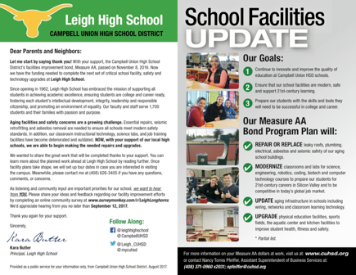
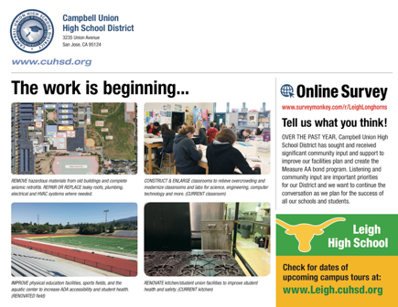
Leigh High School

Slide 9

What do you think about the planned facilities improvements at Leigh High School?
Summer Listening Summary
Top Feedback:
Excited for the improvements as they are much
Have not been informed of plans and the district needs to have this information better publicized
The improvements are great ideas for current and future students
The pool improvement is long overdue

Slide 10
What additional facilities improvements at Leigh High School do you feel should be prioritized?
Summer Listening Summary
Top Feedback:
Air conditioning in every classroom
Bathrooms need to be updated
Better perimeter fencing
Higher quality food options in the cafeteria

Slide 11
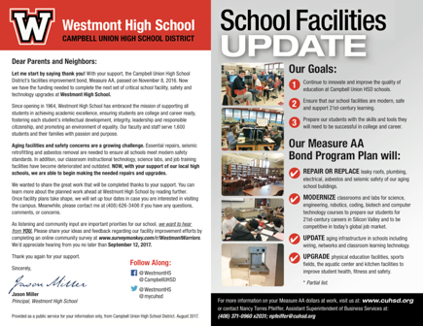
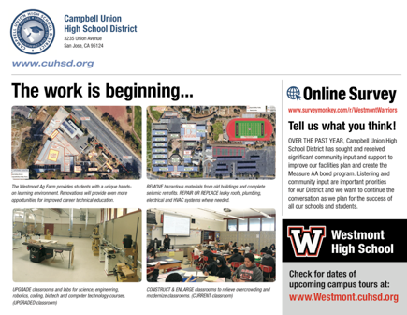
Westmont High School

Slide 12

What do you think about the planned facilities improvements at Westmont High School?
Summer Listening Summary
Top Feedback:
The overall plan is sufficient, with the amount of funds available
This is the first notification of any planned improvements
It’s important to ask the community for input
Really happy that the AG Farm will be getting some improvements

Slide 13
What additional facilities improvements at Westmont High School do you feel should be prioritized?
Summer Listening Summary
Top Feedback:
Improved library and learning center facilities
The theater lobby floods whenever there is a big rain
The plan covers what's needed
Modern science and technology centers
Need handicapped accessibility to get into SSC
Air conditioning in every classroom

Slide 14
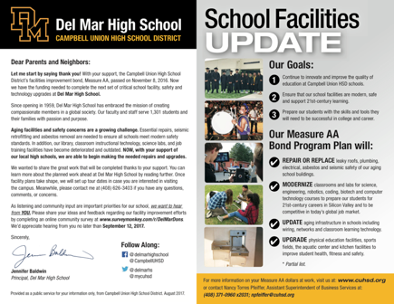
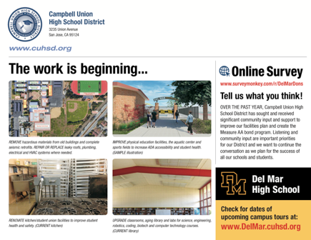
Del Mar High School

Slide 15

What do you think about the planned facilities improvements at Del Mar High School?
Summer Listening Summary
Top Feedback:
I totally support these planned facilities improvements at Del Mar; they are long overdue
Measure AA will provide many essential upgrades to benefit students, faculty and ultimately, parents and the surrounding community
Thank you for implementing well thought out and much needed upgrades to the Del Mar High School campus

Slide 16
What additional facilities improvements at Del Mar High School do you feel should be prioritized?
Summer Listening Summary
Top Feedback:
Anything that supports hand-on learning
Traffic around the high school in the morning
Create an environment that makes kids excited
Air conditioning in every classroom

Slide 17
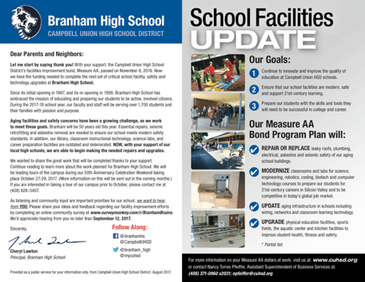

Branham High School

Slide 18

What do you think about the planned facilities improvements at Branham High School?
Summer Listening Summary
Top Feedback:
They are well overdue and a step in the right direction
More information from District about the updated plans
Prefer the money was spent on better resources for the students

Slide 19
What additional facilities improvements at Branham High School do you feel should be prioritized?
Summer Listening Summary
Top Feedback:
Band room, bathrooms, lockers
Lighting the hallways
None - get the current high priorities done. These should have been completed before a new football field
Air conditioning in every classroom

Slide 20
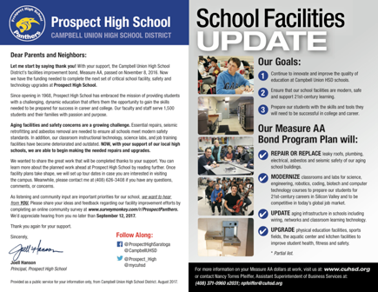

Prospect High School

Slide 21

What do you think about the planned facilities improvements at Prospect High School?
Summer Listening Summary
Top Feedback:
Excited! Much needed
The cafeteria/student union is the most compelling since the cafeteria is not used for really much at this point
Like the idea of 2 story pre-cast buildings since Prospect has a fairly small footprint
Didn't know much about it until I took this survey

Slide 22
What additional facilities improvements at Prospect High School do you feel should be prioritized?
Summer Listening Summary
Top Feedback:
Fix or remove the broken lockers
Graffiti removal
Bathrooms
Designated and well-marked recycling and trash containers
Air conditioning in every classroom

Slide 23
5111 Telegraph Ave. #307
Oakland, CA 94609
www.cliffordmoss.com
Phone: (510) 907-3195

